Slide 1
Lecture 2: Software Processes
Recommended Books for the Slides:
Lan Sommerville. Software Engineering, 5th/6th/7th/8thedition
Roger S. Pressman. Software Engineering
Elias M. Awad. Systems Analysis and Design
4) M. Blaha and J. Rumbaugh. Object Oriented Modeling and
Design with UML.

Slide 2
The software process
A structured set of activities required to develop a software system.
Many different software processes but all involve:
Specification – defining what the system should do;
Design and implementation – defining the organization of the system and implementing the system;
Validation – checking that it does what the customer wants;
Evolution – changing the system in response to changing customer needs.
A software process model is an abstract representation of a process. It presents a description of a process from some particular perspective.

Slide 3
Software process descriptions
The activities in these processes such as specifying a data model, designing a user interface, etc. and the ordering of these activities.
Process descriptions may also include:
Products, which are the outcomes of a process activity;
Roles, which reflect the responsibilities of the people involved in the process;
Pre- and post-conditions, which are statements that are true before and after a process activity has been enacted or a product produced.

Slide 4
Plan-driven and Agile processes
Plan-driven processes are processes where all of the process activities are planned in advance and progress is measured against this plan.
In Agile processes, planning is incremental and it is easier to change the process to reflect changing customer requirements.
In practice, most practical processes include elements of both plan-driven and agile approaches.
There are no right or wrong software processes.

Slide 5
Software process models
The waterfall model
Plan-driven model. Separate and distinct phases of specification and development.
Incremental development
Specification, development and validation are interleaved. May be plan-driven or agile.
Integration and configuration
The system is assembled from existing configurable components. May be plan-driven or agile.
In practice, most large systems are developed using a process that incorporates elements from all of these models.

Slide 6
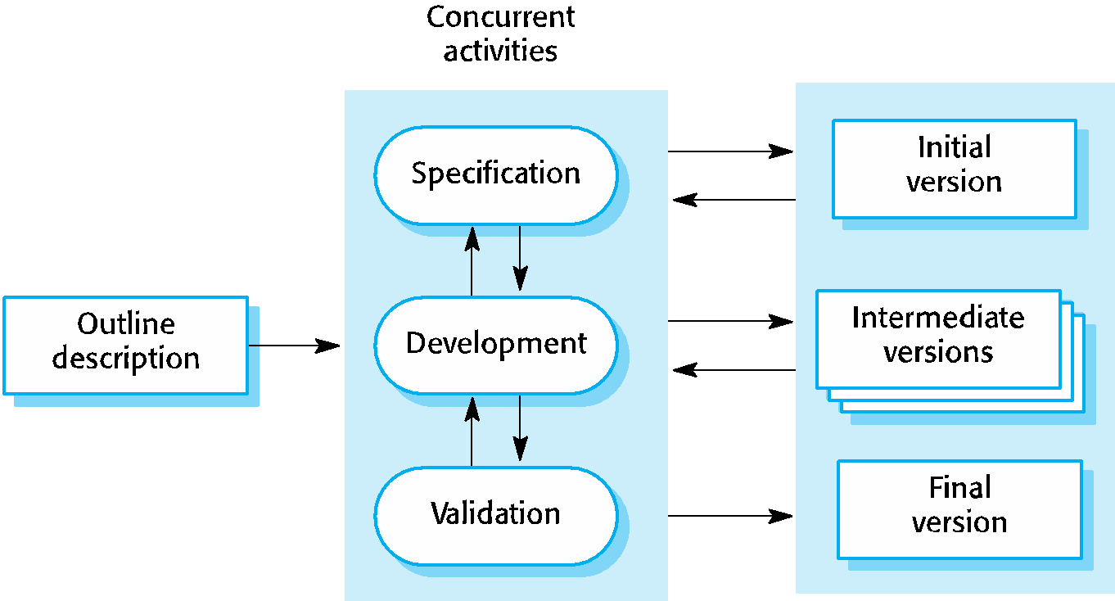
Incremental development

Slide 7
Incremental development benefits
The cost of accommodating changing customer requirements is reduced.
It is easier to get customer feedback on the development work that has been done.
More rapid delivery and deployment of useful software to the customer is possible.

Slide 8
Incremental development problems
The process is not visible.
Managers need regular deliverables to measure progress.
System structure tends to degrade as new increments are added.
Unless time and money is spent on refactoring to improve the software, regular change tends to corrupt its structure. .

Slide 9
Process activities
Real software processes are inter-leaved sequences of technical, collaborative and managerial activities with the overall goal of specifying, designing, implementing and testing a software system.
The four basic process activities of
Specification
Development
Validation and
Evolution
are organized differently in different development processes.
For example, in the waterfall model, they are organized in sequence, whereas in incremental development they are interleaved.

Slide 10
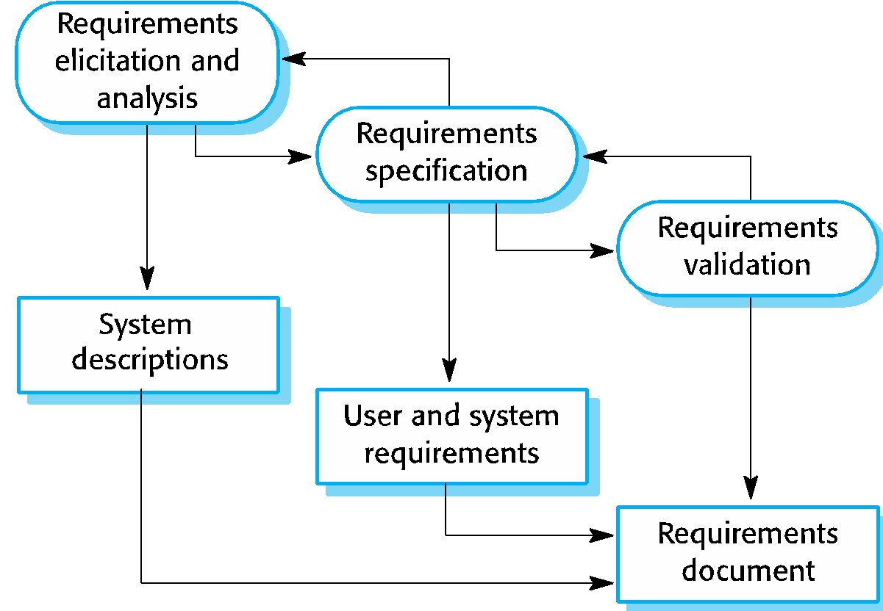
The requirements engineering process

Slide 11
Software specification
The process of establishing what services are required and the constraints on the system’s operation and development.
Requirements engineering process
Requirements elicitation and analysis
What do the system stakeholders require or expect from the system?
Requirements specification
Defining the requirements in detail
Requirements validation
Checking the validity of the requirements

Slide 12
Software design and implementation
The process of converting the system specification into an executable system.
Software design
Design a software structure that realises the specification;
Implementation
Translate this design structure into an executable program;
The activities of design and implementation are closely related and may be inter-leaved.

Slide 13
Design activities
Architectural design, where we identify the overall structure of the system, the principal components (subsystems or modules), their relationships and how they are distributed.
Database design, where we design the system data structures and how these are to be represented in a database.
Interface design, where we define the interfaces between system components.
Component selection and design, where we search for reusable components. If unavailable, we design how it will operate.

Slide 14
The Model-View-Controller (MVC) pattern for Architectural Design
Name: MVC (Model-View-Controller)
Description
Separates presentation and interaction from the system data. The system is structured into three logical components that interact with each other.
The Model component manages the system data and associated operations on that data.
The View component defines and manages how the data is presented to the user.
The Controller component manages user interaction (e.g., key presses, mouse clicks, etc.) and passes these interactions to the View and the Model. See Figure 6.3.

Slide 15
The Model-View-Controller (MVC) pattern
Example
Figure 6.4 shows the architecture of a web-based application system organized using the MVC pattern.
When used
Used when there are multiple ways to view and interact with data. Also used when the future requirements for interaction and presentation of data are unknown.
Advantages
Allows the data to change independently of its representation and vice versa. Supports presentation of the same data in different ways with changes made in one representation shown in all of them.
Disadvantages
Can involve additional code and code complexity when the data model and interactions are simple.

Slide 16
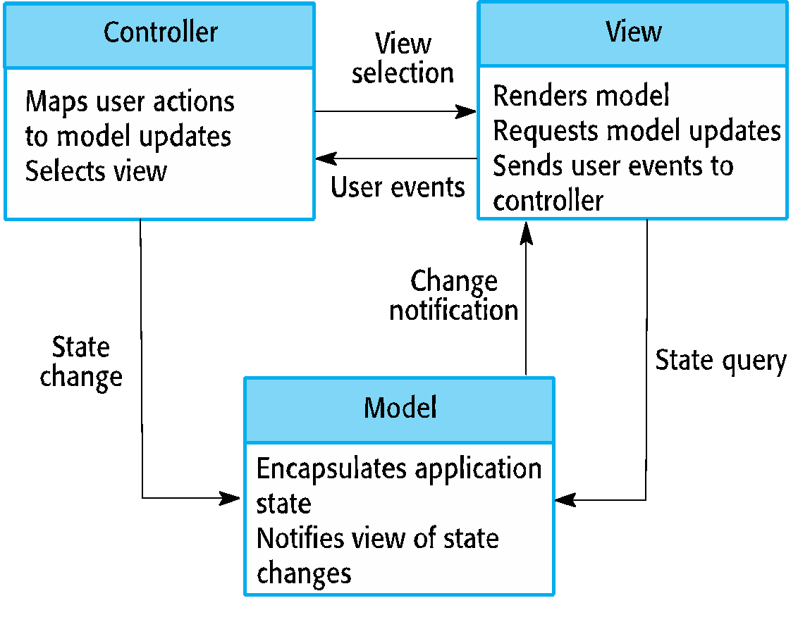
The organization of the Model-View-Controller

Slide 17
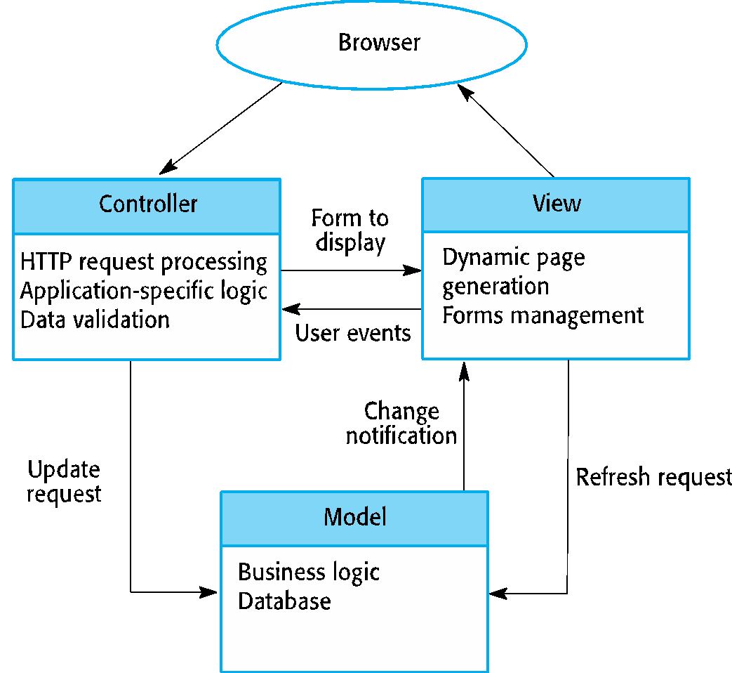
Web application architecture using the MVC pattern

Slide 18
System implementation
The software is implemented either by developing a program or programs or by configuring an application system.
Design and implementation are interleaved activities for most types of software system.
Programming is an individual activity with no standard process.
Debugging is the activity of finding program faults and correcting these faults.

Slide 19
Software Verification and Validation
(V & V)
Verification is intended to show that a system conforms to its specification
Validation is intended to show that a system meets the requirements of the system customer
Involves checking and review processes and system testing.
System testing involves executing the system with test cases that are derived from the specification of the real data to be processed by the system.
Testing is the most commonly used V & V activity.

Slide 20
Software prototyping
A prototype is an initial version of a system used to demonstrate concepts and try out design options.
A prototype can be used in:
The requirements engineering process to help with requirements elicitation and validation;
In design processes to explore options and develop a UI design;
In the testing process to run back-to-back tests.

Slide 21
Benefits of prototyping
Improved system usability.
A closer match to users’ real needs.
Improved design quality.
Improved maintainability.
Reduced development effort.

Slide 22
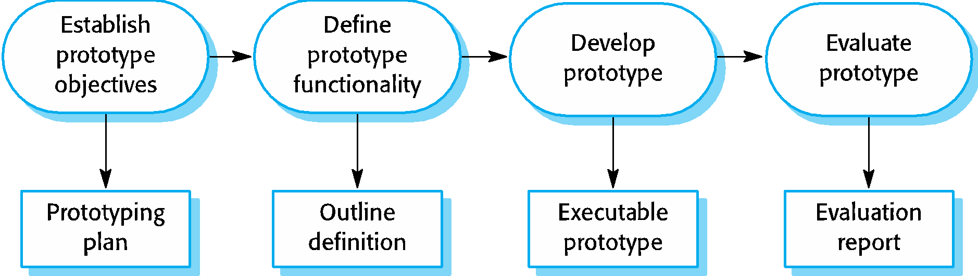
The process of prototype development

Slide 23
Prototype development
May be based on rapid prototyping languages or tools
May involve leaving out functionality
Prototype should focus on areas of the product that are not well-understood;
Error checking and recovery may not be included in the prototype;
Focus on functional rather than non-functional requirements such as reliability and security

Slide 24
Incremental delivery advantages
Customer value can be delivered with each increment so system functionality is available earlier.
Early increments act as a prototype to help elicit requirements for later increments.
Lower risk of overall project failure.
The highest priority system services tend to receive the most testing.

Slide 25
Incremental delivery problems
Most systems require a set of basic facilities that are used by different parts of the system.
As requirements are not defined in detail until an increment is to be implemented, it can be hard to identify common facilities that are needed by all increments.
The essence of iterative processes is that the specification is developed in conjunction with the software.
However, this conflicts with the procurement model of many organizations, where the complete system specification is part of the system development contract.

Slide 26
Process metrics
Time taken for process activities to be completed
E.g. Calendar time or effort to complete an activity or process.
Resources required for processes or activities
E.g. Total effort in person-days.
Number of occurrences of a particular event
E.g. Number of defects discovered.

